Slide 1

ABP Community Talks 2022.3 DDD, EventHub & the ABP Book

Slide 2
ABP

Slide 3

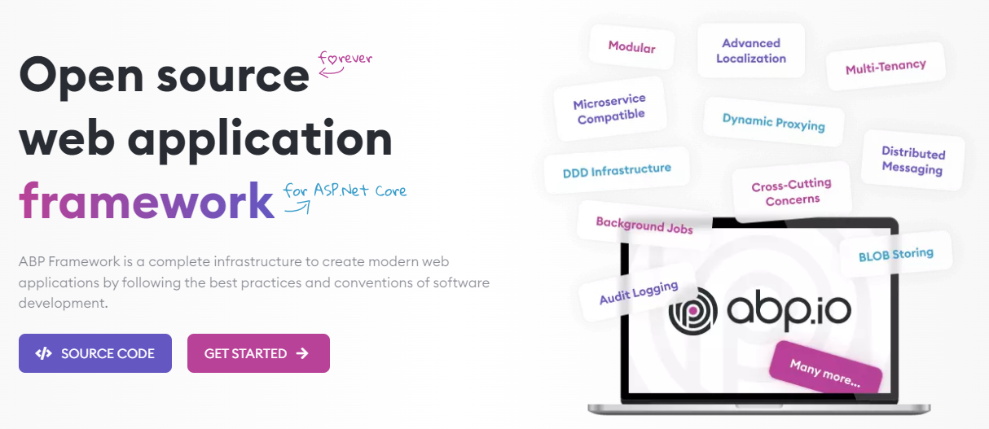
The ABP FRAMEWORK project https://abp.io --- https://github.com/abpframework

Slide 4
ABP Framework: Architecture
Domain Driven Design
& Layered Solution
Modular
Multi-Tenancy (SaaS infrastructure)
Microservice ready

Slide 5
ABP Framework: Infrastructure Enterprise application requirements
Cross-cutting concerns
Authentication & authorization
UI theming system & utilities
Distributed event bus
Audit logging
Background jobs
Setting management
Data filtering & soft-delete
Dynamic client-side proxies
Dynamic forms
…more

Slide 6
ABP Framework: Pre-built modules
Account (login, register, …)
IdentityServer
File Management
Identity (users, roles, …)
Docs (technical documentation)
Forms
Multi-Tenancy (tenant management)
Audit Log Reporting
Payment
CMS Kit
(content management system components)
Language Management
Chat

Slide 7
ABP Framework: Startup templates

Slide 8
EVENTHUB

Slide 9
EventHub github.com/volosoft/eventhub
An open-source reference application for implementing Domain Driven Design with the ABP Framework.
Explained in the Mastering ABP Framework book.
Thought as a real-world, live application.
Configured to run with Kubernetes & Project Tye.

Slide 10
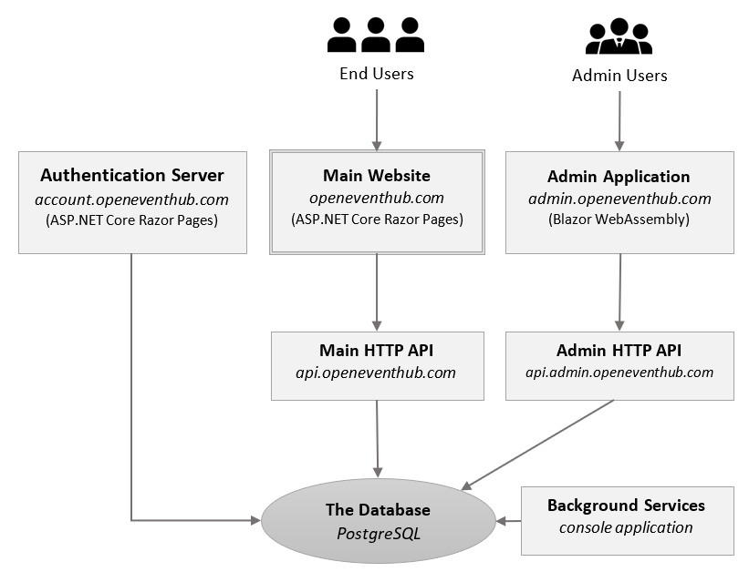
EventHub: The architecture
Two web applications:
Main website (Razor Pages)
Admin application (Blazor WASM)
Authentication server (built with the IdentityServer4)
Two API endpoints (one for each web application)
Background service (console application)

Slide 11
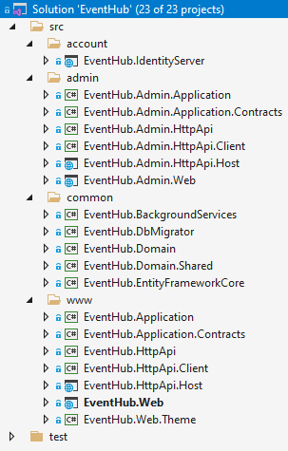
EventHub: The architecture
Two web applications:
Main website (Razor Pages)
Admin application (Blazor WASM)
Authentication server (built with the IdentityServer4)
Two API endpoints (one for each web application)
Background service (console application)

Slide 12
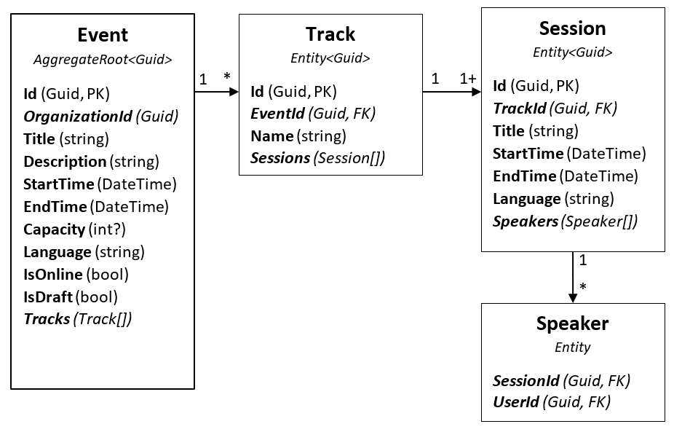
EventHub: The domain

Slide 13
EventHub: The application
DEMO!
openeventhub.com

Slide 14
Title
TODO: ...

